Slide 1
DATA ANALYTICS PROJECT
Retail Sales &
Customer Analysis
Turning transaction data into useful business insights
by
[PAVEEN KUMAR N]

Slide 2
Presentation Overview
01
Project objective
What the analysis is designed to answer
02
Dataset & preparation
Data structure and quality checks
03
Analysis approach
Excel formulas, PivotTables and comparisons
04
Dashboard & findings
KPIs, trends, products and countries
05
Recommendations
Actions supported by evidence
2

Slide 3
Project Objective
Understand sales performance and customer activity using Excel.
Main objective
Key business questions
Analyze retail transactions to identify revenue patterns, product performance, customer activity and country-level differences.
• How much revenue and order activity are recorded?
• Which products perform best and worst by sales?
• How does revenue change over time?
• Which countries contribute most to sales?
• What data-quality issues could affect decisions?
3

Slide 4
Dataset at a Glance
Workbook structure and analysis scope.
CLEANED RECORDS
INVOICES
CUSTOMERS
PRODUCTS
COUNTRIES
96,458
5,824
2,200
~2,900
30
Rows in Clean Data
Distinct invoice count
Distinct customer IDs
Distinct stock codes
Geographic coverage
Core fields
Derived fields
• Invoice, StockCode and Description
• Quantity, InvoiceDate and Price
• Customer ID, Country and Sales Revenue
• Year, Quarter and Month
• Month Number for chronological sorting
• Weekday and Quality Status
4

Slide 5
Key Performance Indicators
Use consistent definitions so that the numbers can be trusted.
Total revenue
Orders
Customers
Sum of Sales Revenue
Distinct Invoice count
Distinct Customer ID
Validate return treatment
Do not count rows
Review missing IDs
Units sold
Average order value
Sum of Quantity
Revenue ÷ distinct orders
Separate returns if appropriate
Use consistent revenue basis
.
7

Slide 6
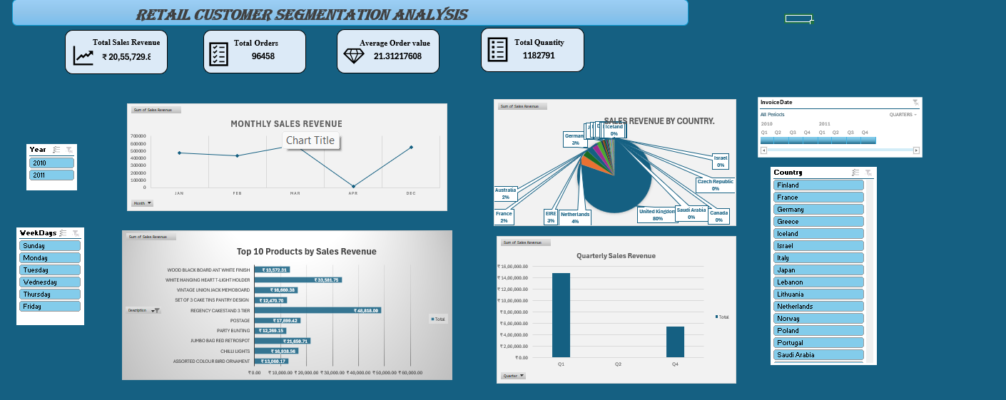
DASHBOARD
9

Slide 7
Business Recommendations
Turn validated findings into practical next steps.
Product decisions
Prioritize consistently strong products; investigate weak performers before changing stock or promotions.
Market focus
Compare high-revenue countries with order volume and customer activity.
Customer retention
Use customer summaries to identify repeat buyers and retention opportunities.
Data governance
Maintain checks for returns, missing IDs, duplicates and revenue reconciliation.
Reporting cadence
Refresh the Excel Table and PivotTables regularly; use slicers for focused review.
RETAIL SALES & CUSTOMER ANALYSIS | EXCEL PROJECT
10

Slide 8
CONCLUSION
From raw transactions to clearer decisions
• Excel supports data cleaning, calculation, summarization and interactive reporting.
• Clear KPI definitions help compare sales, orders, customers and products.
• Validating returns and reconciling totals is essential before sharing conclusions.
Thank you
Questions & discussion

